Slide 1
Tuesday
August 09,2016
Note – Homework – Frayer model-Due 8/12
Quiz – classifying matter-Friday, the 12th
By the end of the day, Scholars will be able to:
GPS -
SPS2
Students will explore the nature of matter, its
classifications, and its system for naming types of matter.
Catalyst:
Compare and contrast an element and a compound.
Our goal is 80%
understand the nature of matter, its classifications, and its system for naming types of matter.
And answer a question like this:
Classify the following matter as heterogeneous or homogeneous mixtures, or element or compound.
1. Air
Topic: Classification of matter
Essential Question: What is the difference between an element, compound and a mixture?

Slide 2
Agenda - Milestones Domain/Weight:
Chemical Reactions and Properties of Matter 25%
Catalyst | 10 min
Classification of matter – Review | 30 min
Matter – GO - complete | 15 min
Matter video | 7 min
Classifying matter worksheet | 25min

Slide 3
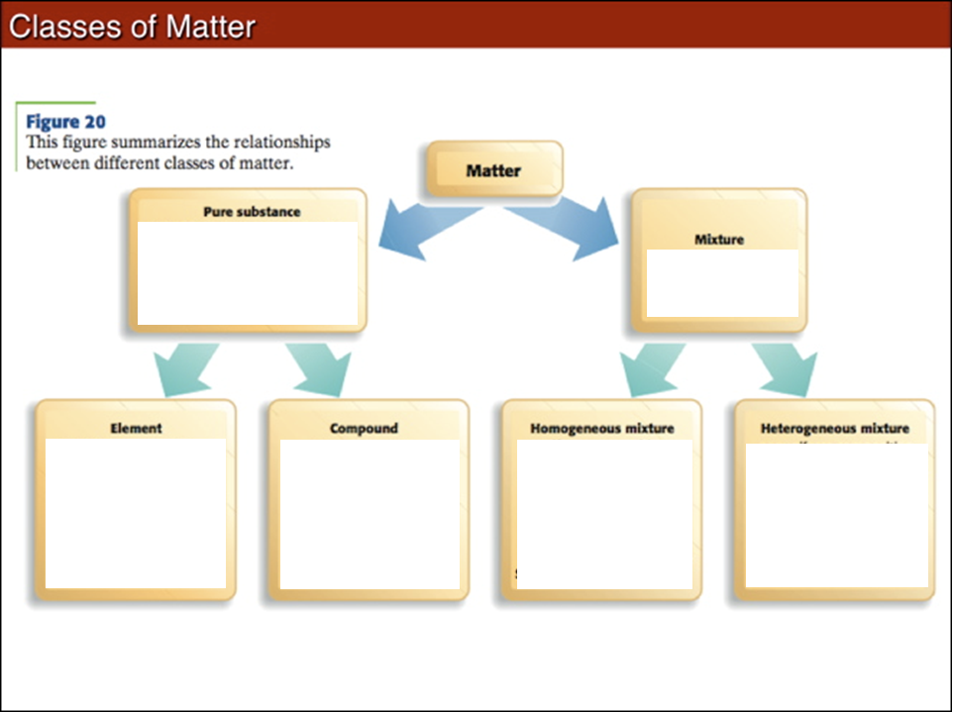

Slide 4
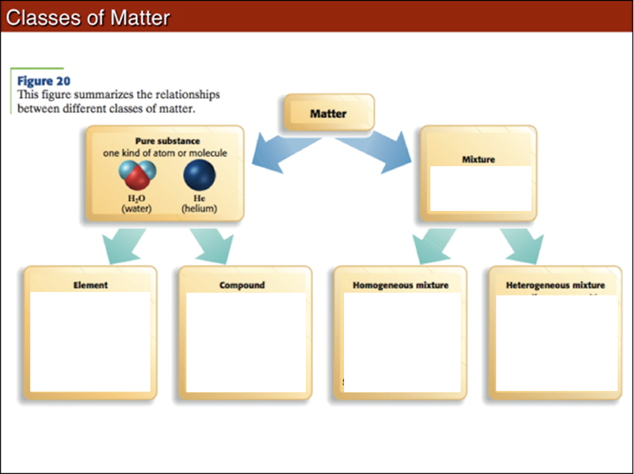

Slide 5
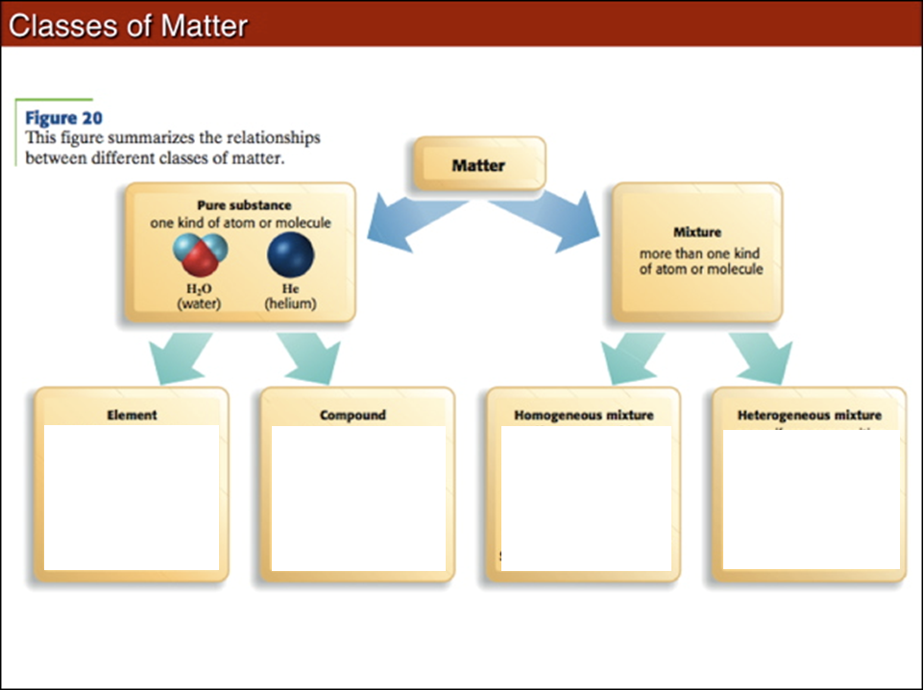

Slide 6
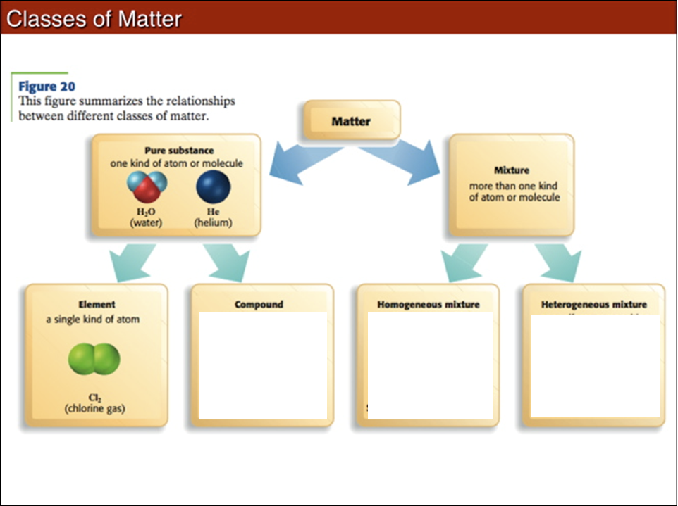

Slide 7
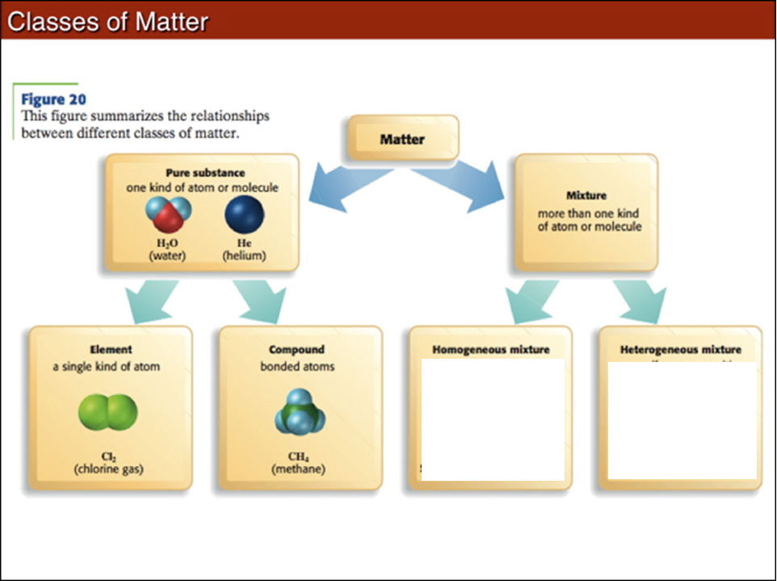

Slide 8
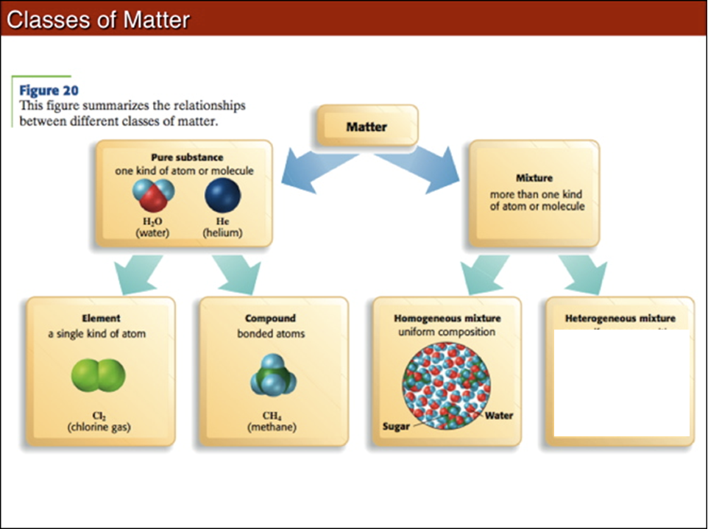

Slide 9
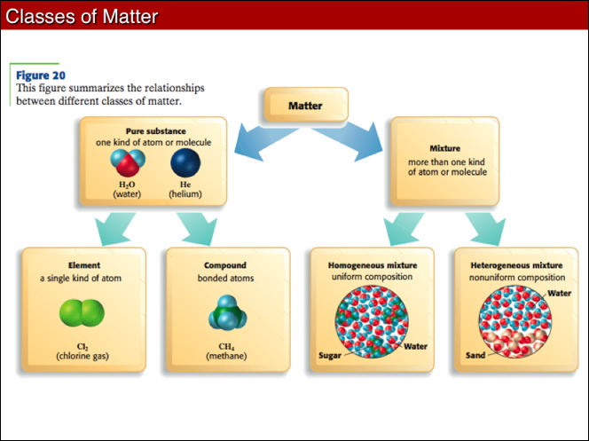

Slide 10
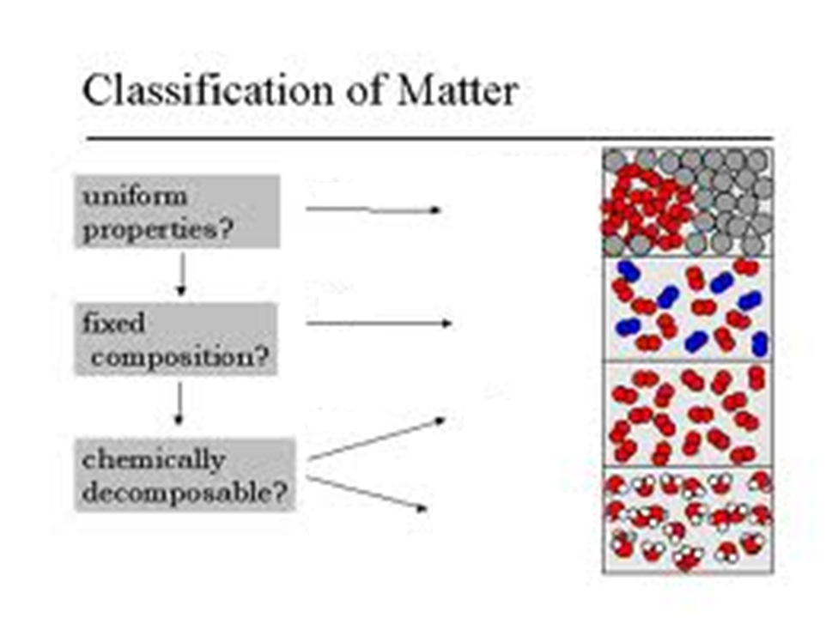

Slide 11
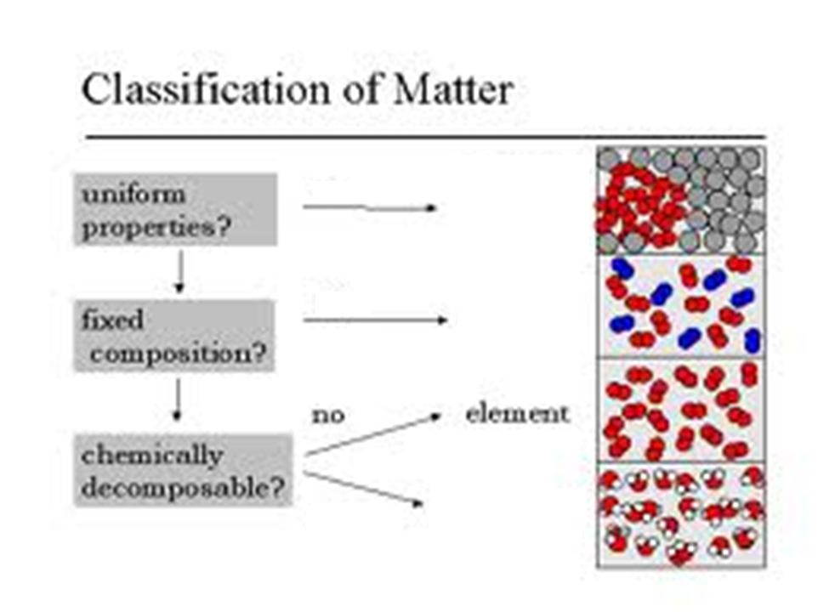

Slide 12
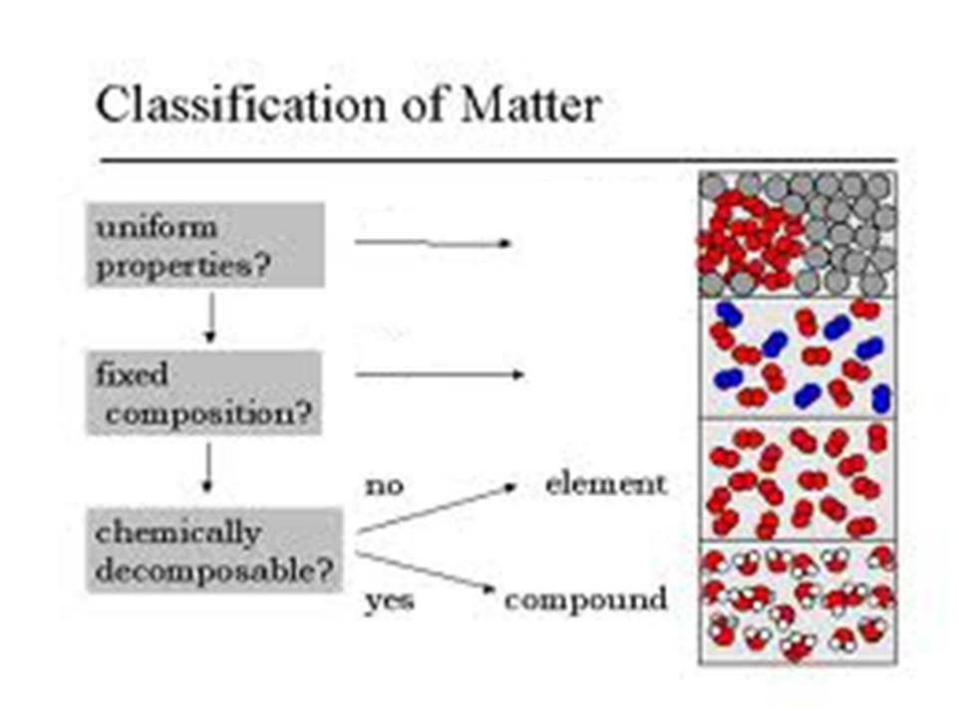

Slide 13
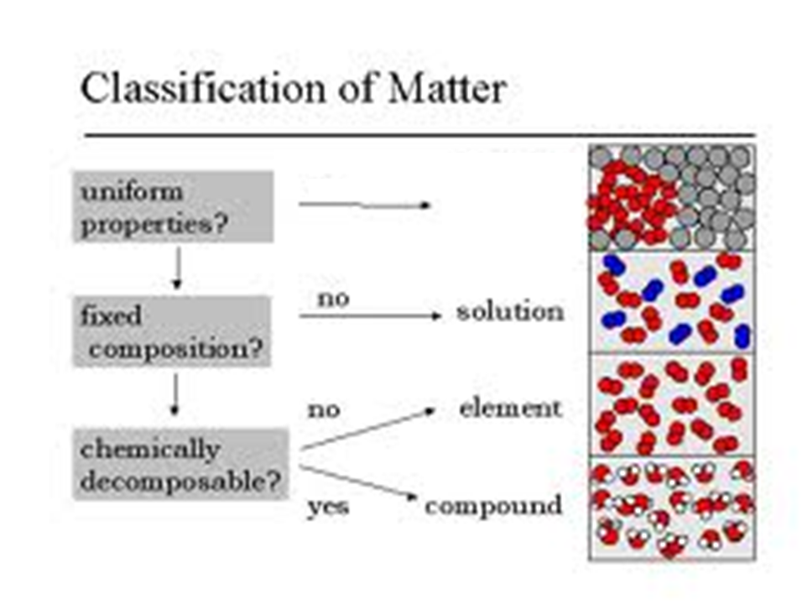

Slide 14


Slide 15
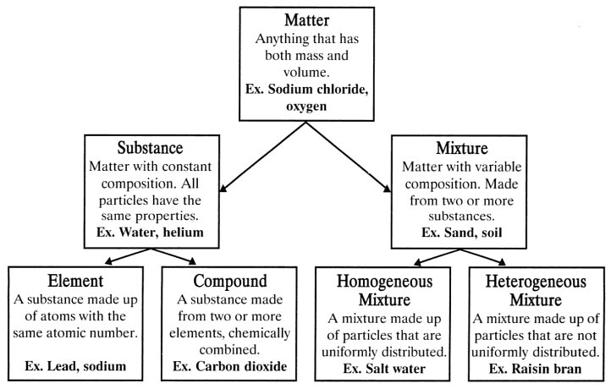

Slide 16
Element
Homogeneous
Compound
Heterogeneous
Magnesium (Mg)
Mercury (Hg) Boron (B)
Iron (Fe) Manganese (Mn)
Helium (He)
Carbon (C)
Silicon (Si)
Cobalt (Co)
Gold (Au)
Carbon dioxide (CO₂)
Magnesium oxide (MgO)
Sodium hydroxide (NaOH)
Calcium Chloride (CaCl₂)
Iron oxide (Fe₂O₃)
Magnesium sulfide (MgS)
Copper I oxide (Cu₂O)
Rust (Fe₂O₃) Pure Water (H₂O)
Carbon Monoxide (CO)
12 Karat Gold Milk
Coke w/o ice Tomato Soup
Air Hot Tea
Kool-Aid Tap Water
Blood Traditional Coffee
Vinegar
Weak solution of Hydrochloric acid
Coke w/ ice
Muddy water Trail Mix
Turkish coffee Spaghetti
Tea w/ ice Chunky Salsa
Oil and vinegar salad dressing
Chocolate Chip Cookie
Chicken noodle soup

Slide 17
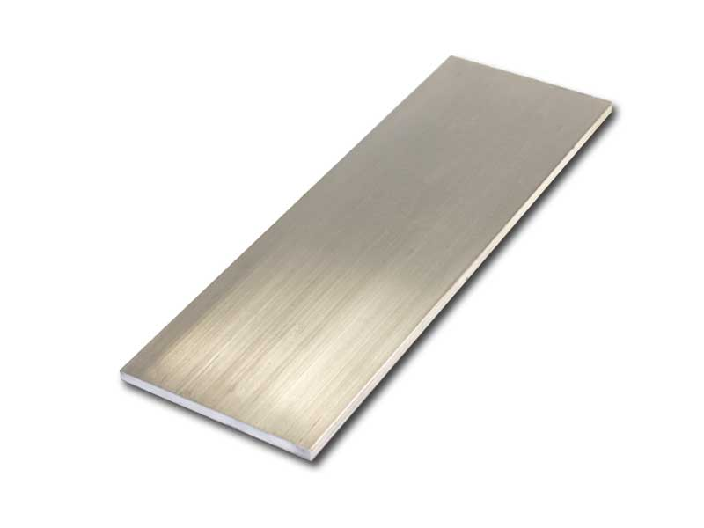
What kind of matter is Aluminum (Al)?
Why?

Slide 18
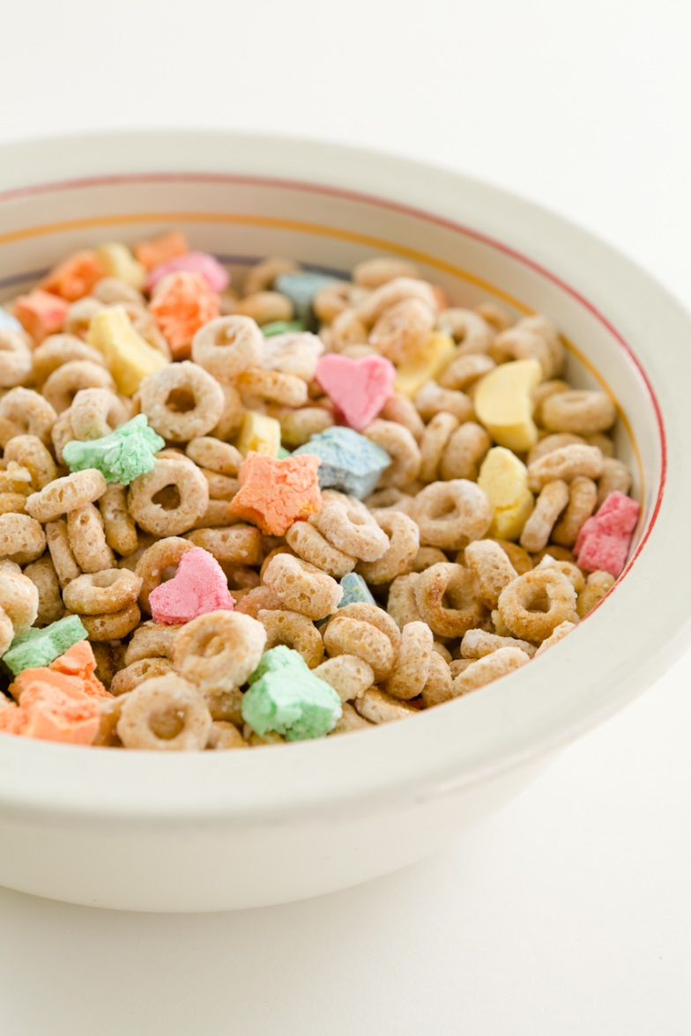
What kind of matter is Lucky Charms cereal?
Why?

Slide 19
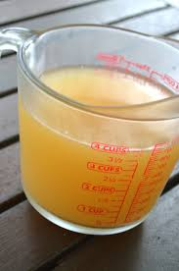
What kind of matter is chicken broth?
Why?

Slide 20
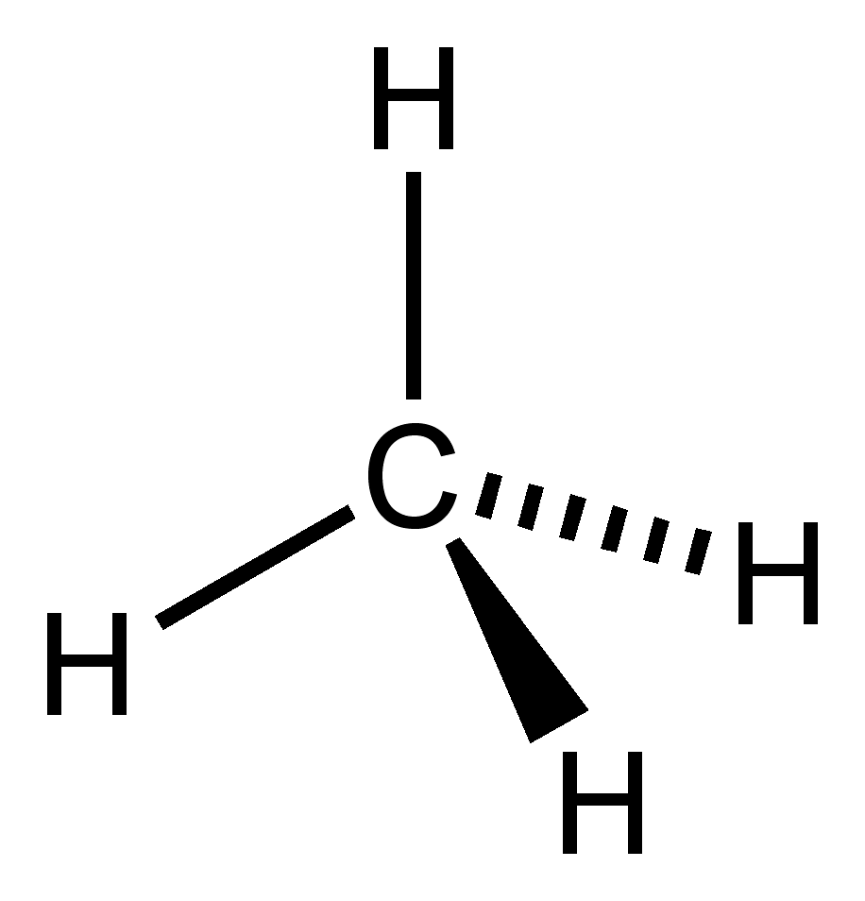
What kind of matter is methane (CH₄)?
Why?

Slide 21
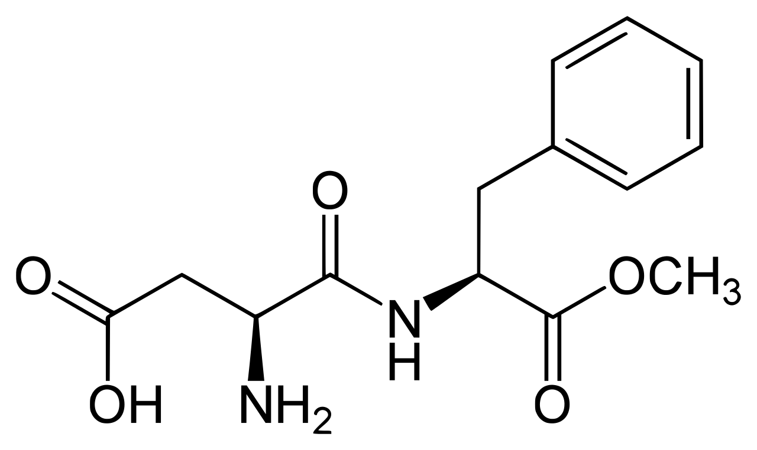
What kind of matter is aspartame (C₁₄H₁₈N₂O₅)?
Why?

Slide 22

What kind of matter is ocean water?
Why?

Slide 23
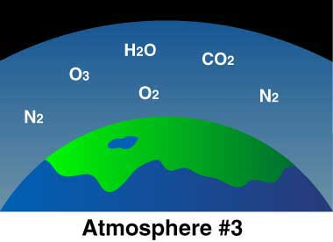
What kind of matter is the air in the atmosphere?
Why?

Slide 24
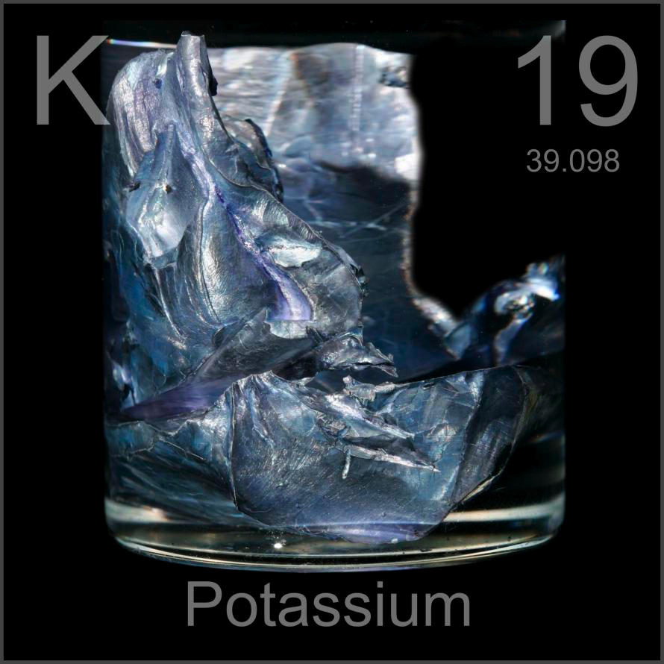
What kind of matter is Potassium (K)?
Why?

Slide 25
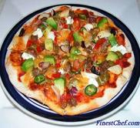
What kind of matter is a pizza?
Why?

Slide 26
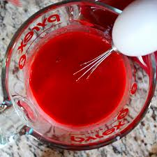
What type of matter is cake batter?
Why?

Slide 27
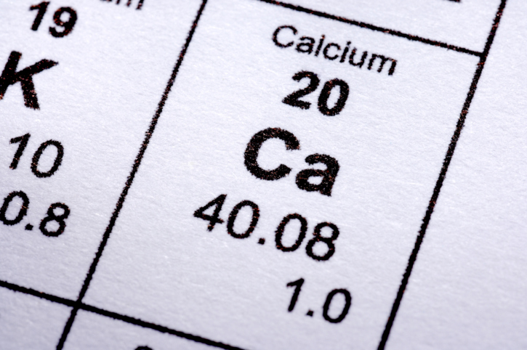
What type of matter is Calcium (Ca)?
Why?

Slide 28
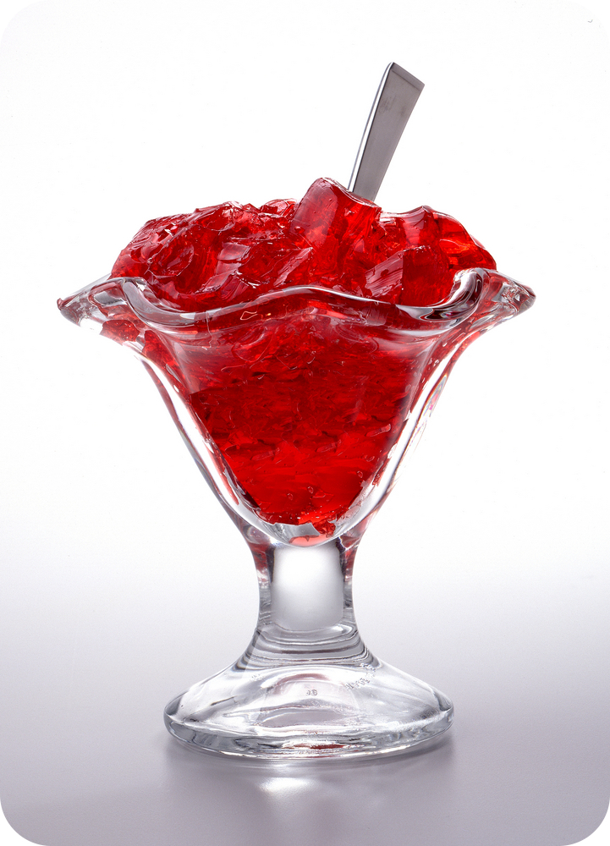
What type of matter is Jello?
Why?

Slide 29
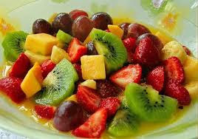
What type of matter is a bowl of fruit?
Why?

Slide 30
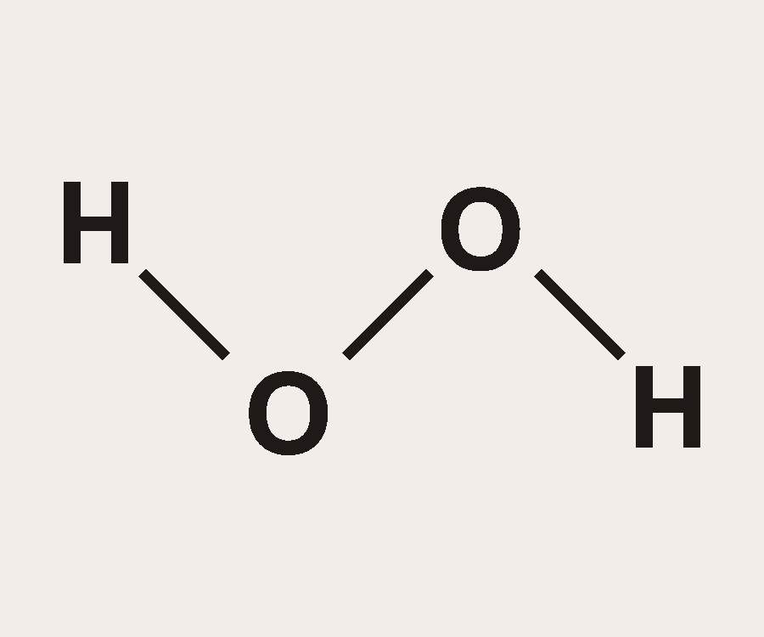
What type of matter is Hydrogen peroxide (H₂O₂)?
Why?

Slide 31
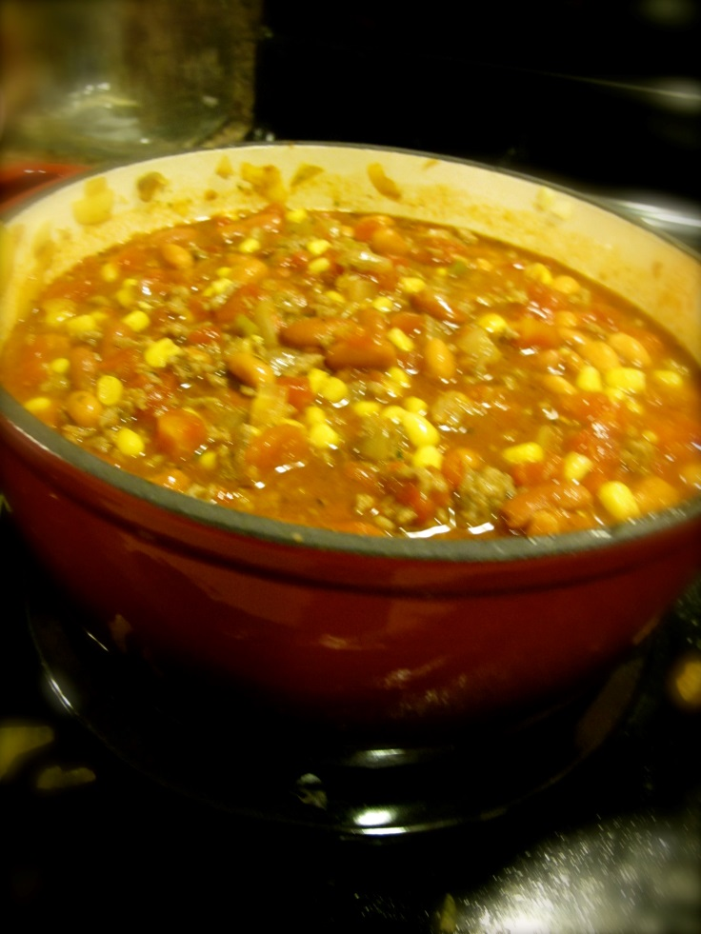
What type of matter is vegetable stew?
Why?

Slide 32
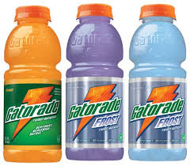
What type of matter is Gatorade?
Why?

Slide 33
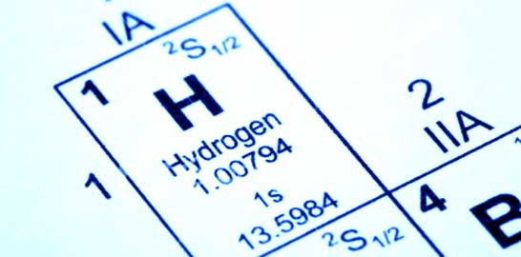
What type of matter is Hydrogen (H)?
Why?

Slide 34
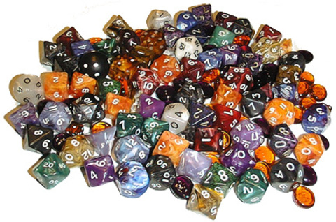
What type of matter is a pile of dice?
Why?

Slide 35
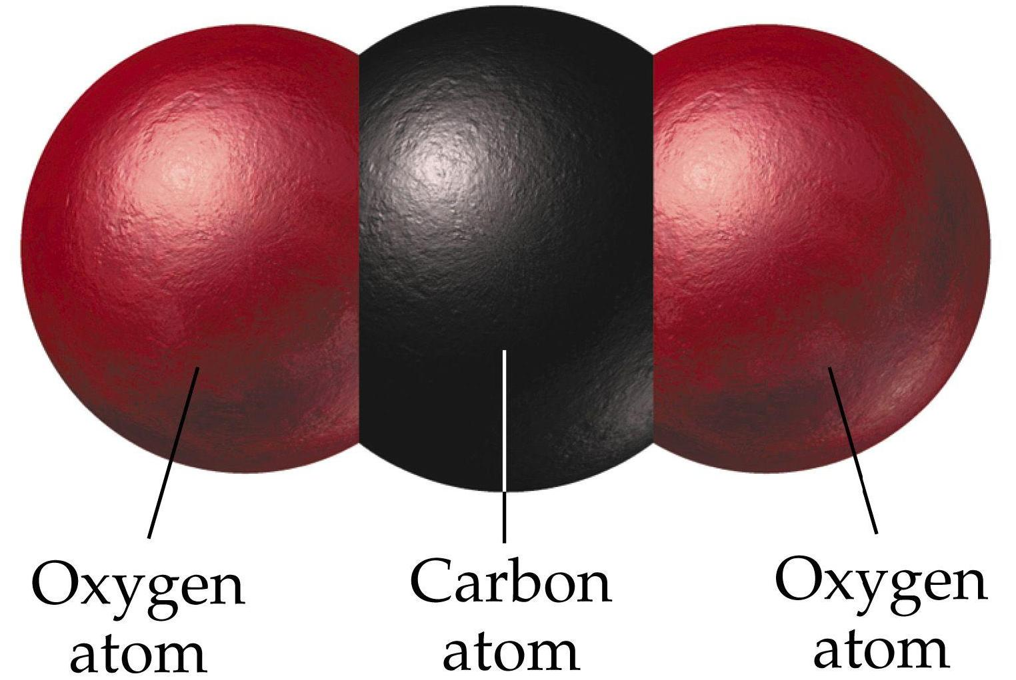
What kind of matter is Carbon dioxide (CO₂)?
Why?

Slide 36
Activator
Take out a sheet of notebook paper
Identify an example of an element, compound, homogeneous and heterogeneous
Tell why your example is classified under the category that you placed it

Slide 37
What kind of matter is an M&M cookie?
Why?

Slide 38
What kind of matter is Kool-Aid?
Why?

Slide 39
What kind of matter is Neon (Ne)?
Why?

Slide 40
What kind of matter is Calcium chloride (CaCl₂)?
Why?

Slide 41
What kind of matter is Carbon monoxide (CO)?
Why?

Slide 42
What kind of matter is Sweet Tea?
Why?

Slide 43
What kind of matter is a Pasta Salad?
Why?

Slide 44
What kind of matter is Fruity Pebbles?
Why?

Slide 45
What kind of matter is Carbon (C)?
Why?

Slide 46
What kind of matter is chocolate pudding?
Why?

Slide 47
What type of matter is a sheet of computer paper?
Why?

Slide 48
What type of matter is the human body?
Why?

Slide 49
What type of matter Is Argon (Ar)?
Why?

Slide 50
What type of matter is Dihydrogen monoxide (H₂O)?
Why?

Slide 51
What type of matter is a glass of tap water with ice?
Why?

